Slide 1
Session 2 – Solving Data Science Problems (Hands-on)
Department of Management Information Systems
Eller College of Management
University of Arizona
Day 2 – Introductory Workshop on Data Science
Karthik Srinivasan
karthiks@email.arizona.edu

Slide 2
Day 2 Contents
Session 2:
Collaborative group task
Introduction to Hadoop
Hadoop based software
Programming in R/Python
Summarizing what we learnt

Slide 3
Collaborative group task
Discuss in groups of 5, for 5 minutes, what Hadoop is, and why it is required.
List all Hadoop-based software application (e.g., HIVE, Hbase, BigTable, etc.) with its icon and a short description of why it is used (e.g., multimedia storage, analytics platform, streaming data applications, etc.) in this padlet:
https://padlet.com/kartucson/u3n535n5xaq0
Upvote an application if you are interested in working on it in the future!
(Task time-frame: 5 + 10 minutes)

Slide 4
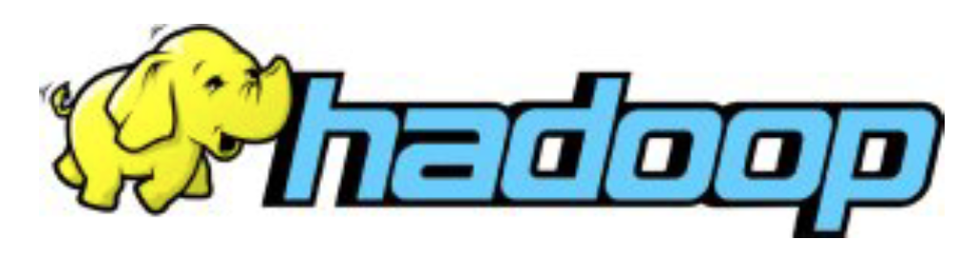
Hadoop
Vertical scaling (e.g., Teradata, mainframe, etc.) becomes expensive, so horizontal scaling based solution to efficiently process large volumes of information
Connecting many commodity computers together to work in parallel.
Implements a simplified programming model (MapReduce) to divide-and-conquer data science tasks (Extract Transform Load (ETL), General data storage, Business Intelligence (BI), Statistical analysis, Optimization, Algorithmic modeling)

Slide 5
Components of Hadoop
The Hadoop Distributed File System (HDFS)
Any type of file can be stored in HDFS
Data is split into chunks and replicated as it is written
Provides resiliency and high availability
Handled automatically by Hadoop
YARN (Yet Another Resource Negotiator)
Manages the processing resources of the Hadoop cluster
Schedules jobs
Runs processing frameworks
MapReduce
A distributed processing framework

Slide 6
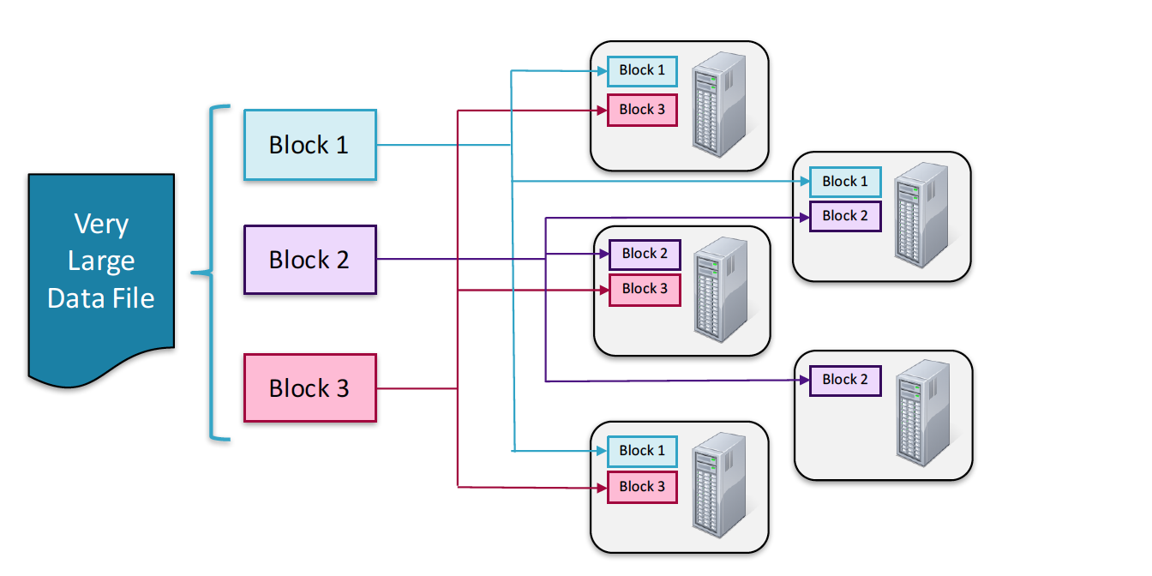
A great starting reference for Hadoop
Image credit: Cloudera essentials for Apache Hadoop
Cloudera Essentials for Apache Hadoop

Slide 7
Hadoop-based software
Lets try some hands-on and try some basic tasks:
Enter data into the HDFS system
Create a HIVE database and copy the data from HDFS system into HIVE database (using Hue?)
Query the HIVE database
Hands-on with Impala
You can use these datasets:
Advertising(Hastie 2009)
Austism (UCI repository)

Slide 8
If you have not installed Cloudera Quickstart VM
Download it from Cloudera website
Download Oracle Virtualbox
Load the Cloudera server image (.vsdx) into virtualbox
Start the server
Enable birectional read-write

Slide 9
Exchanging data between Cloudera VM and Local
Option 1: Settings → Advanced → Drag and drop → bidirectional
Option 2: Create shared folder in local and mount it on cloudera server
Lets do this together…
Create a shared folder (permanent) in Cloudera server (lets call it cloudera_shared)
Mount the server into the server
mount -t vboxsf cloudera_shared /home/cloudera/Downloads/cloudera_shared/

Slide 10
Step 1: Move data into HDFS
Copy advertising.csv into the local drive of the server that you are using. Note the location and its address
Some file Management commands:
Make a folder in HDFS
hadoop fs -mkdir micropost
List files in HDFS – Folders and sub-folders
hadoop fs -lsr
Copy file to hadoop HDFS
hadoop fs -put /home/user/file.ext ./folder_in_HDFS
Delete file:
hdfs dfs -rm -r file.ext
hadoop fs -help
Reference:
http://hortonworks.com/hadoop-tutorial/using-commandline-manage-files-hdfs/

Slide 11
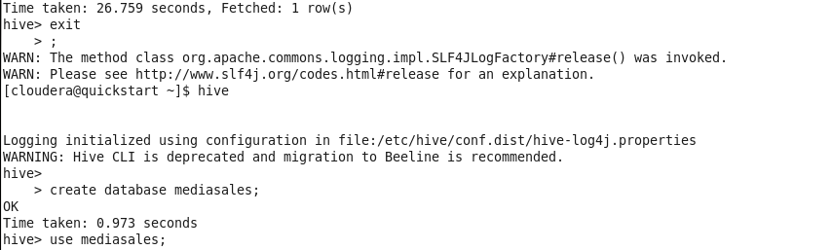
Step 2: Move data into HIVE database
Open the terminal in server that has Hadoop. Type Hive to enter HIVE shell
Create an empty database in HIVE

Slide 12
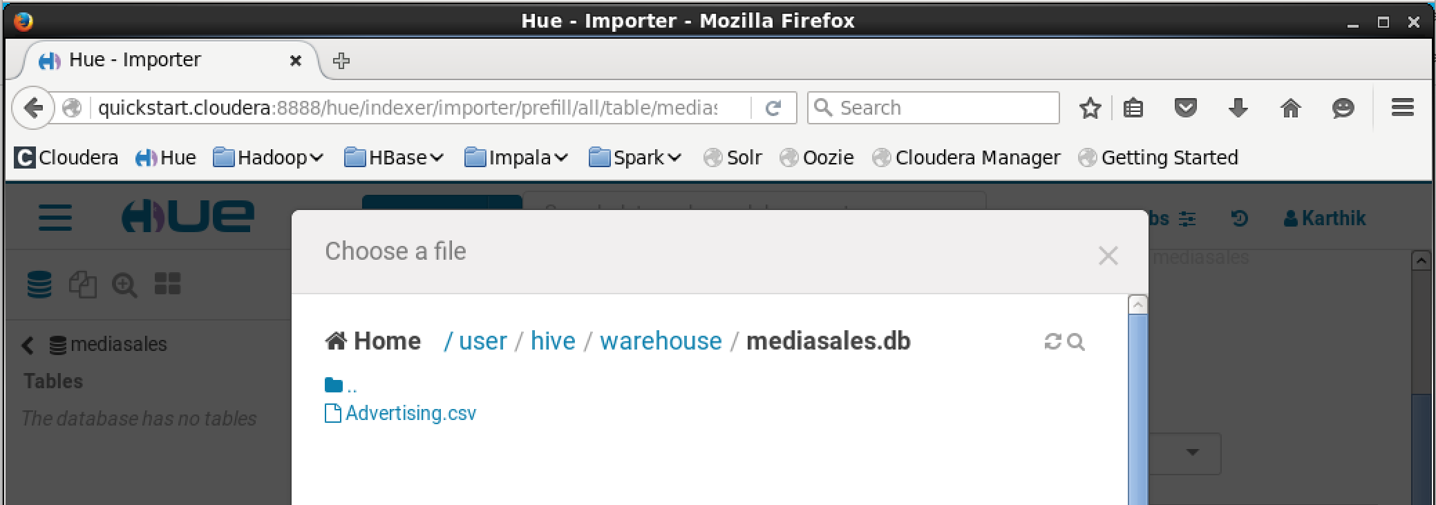
Step 2: Move data into HIVE database (contd.)
Use Hue or HIVE SQL to move data into HIVE table
Cloudera Quickstart doesn’t let us move data to HIVE tables from any folder in HDFS but only in HIVE-warehouse folder, so we move data to HIVE directly using command line
hadoop fs -put /home/cloudera/Downloads/Advertising.csv /user/hive/warehouse/mediasales.db
Copy the data into the HIVE table (using SQL or Hue)
Notes:
create external table test_table(id int, tv float, newspaper float, radio float, sales float)
row format delimited fields
terminated by ','
location ‘/user/hive/warehouse/mediasales.db
';

Slide 13
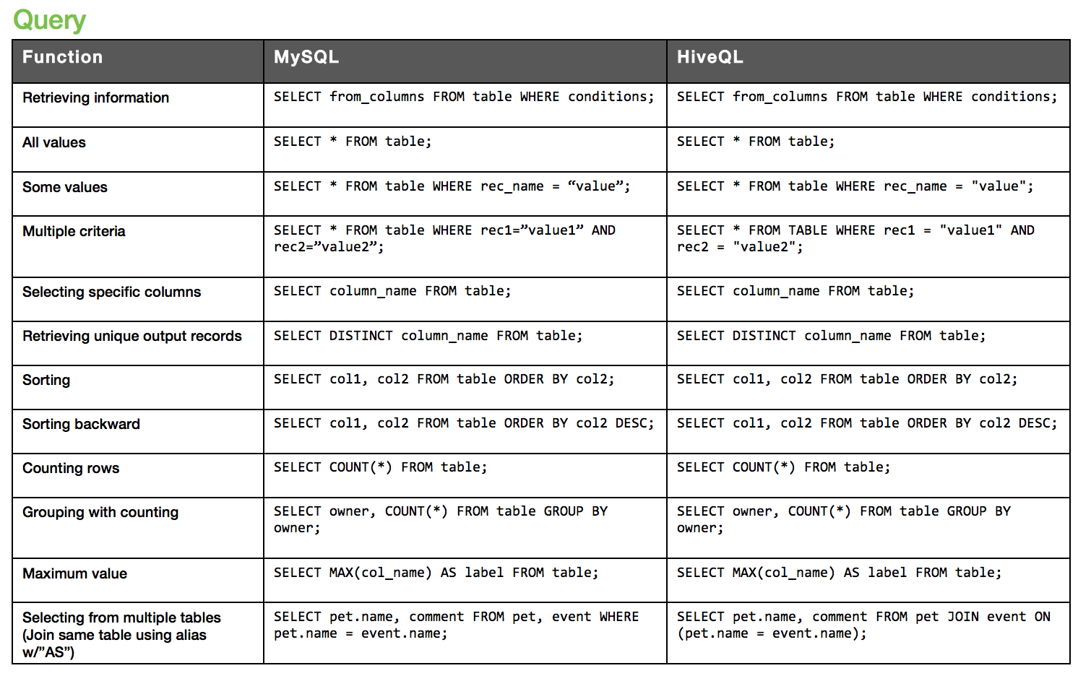
Step 3: Query the HIVE
More or less, all DBMS SQL queries work for HIVE and other Hadoop based structured databases
SAME
Hortonworks SQL to HIVE cheatsheet:
http://hortonworks.com/wp-content/uploads/2016/05/Hortonworks.CheatSheet.SQLtoHive.pdf

Slide 14
Try Impala
Use the same steps we followed for HIVE (in previous few slides).
Only here, you enter Impala shell using ‘Impala-shell’ command instead of typing ‘Hive’
Compare HIVE and Impala, which is faster?

Slide 15
Try Impala
Use the same steps we followed for HIVE (in previous few slides).
Only here, you enter Impala shell using ‘Impala-shell’ command instead of typing ‘Hive’
Compare HIVE and Impala, which is faster?

Slide 16
Programming in R/Python
Best way to learn languages for data science is:
Learn syntax, print cheat sheets of language
Do online courses or just read documentation
Write sample code / Capstone projects
Have the ‘Just get the job done’ mentality for programming for data analysis
Learn about packages and code for:
data collection
data structuring,
data processing,
BI and reporting
data visualization
quantitative modeling
Making prediction

Slide 17
Programming in R/Python
Sample reading resources:
Data Mining with R – Yangchang Zhao
Python for Data Analysis – Wes McKinney
Lets do some hands-on:
Linear regression:
outcome = a.x + b.y + Error
You can use Python and R you have installed or cloud versions here: R Studio Cloud, Python Anywhere
Code will be available on Etherpad:
https://etherpad.net/p/IntroDataScience
Notes:
Sudo yum install python-pip in Python anywhere

Slide 18
Try at home
Simple examples on data analysis using spark in databricks: https://databricks.com/resources/type/example-notebooks
Google colab for deep learning examples: https://colab.research.google.com/github/tensorflow/docs/blob/master/site/en/tutorials/keras/basic_regression.ipynb
Notes:
Sudo yum install python-pip in Python anywhere

Slide 19
Summarizing what we learnt
??
This slide will be populated post discussion at the workshop

Slide 20
Concluding remarks
This is an ‘introductory’ workshop.
The purpose of this workshop is to introduce you to the depth and width of data science and show you a path for self-improvement
Keep programming, keep reading, keep blogging
Topics covered in this workshop may not overlap with data mining, web mining and other courses, but will give you a background
Help you with internships and job hunts. Keep doing online courses and voluntary projects.
Any questions, always welcome to reach out to anyone at the MIS department (including us)
Enjoy the data deluge, we are in the golden age of big data

Slide 21
Thank you

